Slide 1

ADS Group Seminar ai-ds a b2 group 8
PRIORITY QUEUE

Slide 2

Introduction
A priority queue is a special type of queue in which each element is associated with a priority value. And, elements are served on the basis of their priority.
The priority of the elements in a priority queue determines the order in which elements are removed from the priority queue. Therefore all the elements are either arranged in an ascending or descending order.
A priority Queue is an extension of the queue with the following properties.
1} Every item has a priority associated with it.
2} An element with high priority is dequeued before an element with low priority.
3} If two elements have the same priority, they are served according to FIFO operation.

Slide 3
Operation And Implementation of PQ
Operations performed on priority queue are :
Enqueue
Dequeue
Peek
Priority queue can be implemented using the following data structures:
Arrays
Linked list
Heap data structure
Binary search tree
Notes:
Emoji & Diagram

Slide 4
Literature Review
SR. No. | Authors | Algorithm(s) | Summary
1. | Jordi Ros-Giralt,Alan Commike | Multiresolution Priority Queues | This paper introduces multiresolution priority queues, a data structure that improves the performance of the standard heap based implementations by trading off a controllable amount of resolution in the space of priorities.
2. | Ali N. Albu-Rghaif; Abbood Kirebut Jassim | A data structure encryption algorithm based on circular queue to enhance data security | In this research, a low complexity circular queue data structure security algorithm is developed. Employing multiple complicating variable factors is the strength of this algorithm and makes recovery of original message by attackers more difficult.
3. | A. Jain, U. Kumar | RESEARCH PAPER ON QUEUES | This research paper discusses about the topics based on queues its applications in daily life and types like queue introduction, priority queue, double ended queue & circular queue and some important topics like the queue interface

Slide 5
Literature Review
SR. No. | Authors | Algorithm(s) | Summary
4 | Claus Jensen (U N I V E R S I T Y O F C O P E N H A G E N) | Improving the efficiency of priority-queue structures | This paper investigate the comparison complexity of operations used in the manipulation of worst-case efficient data structures. The focus of the study is on the design and analysis of priority queues and double-ended priority queues.
5 | -Faouzi Kamoun | Performance Analysis of Two Priority Queuing Systems in Tandem | This paper considers a tandem of two head-of-line (HOL) non-pre emptive priority queuing systems, each with a single server and a deterministic service-time. The paper highlights the fact that the unfairness of the HOL priority scheduling becomes even more noticeable at the network level. Thus this priority mechanism should be used with caution.
6 | Dhananjay Gupta, Avani Kothari | COMPARATIVE STUDY OF PRIORITY QUEUE IMPLEMENTATIONS | This paper analyzes and compares various available ways to implement priority queues.

Slide 6
Literature Review
SR. No. | Authors | Algorithm(s) | Summary
7 | Regi Maliyekkel, Anila M | Comparison of Stack and Queue Data structures | This paper describes the comparative study of the very familiar Data structures Stack and Queue. While solving problems using computers, the data may have to be processed.
8 | Fangzheng Wang | Design based on queue data structure and its implementation in DNA computer | This paper analyses the concept of queue, the storage structure of the queue data and encoding of the queue data based on queue data. After analysing and giving an expression to the main structure of queue encoding, this paper discusses DNA encoding process of queue data through instance.

Slide 7

Characteristics of Priority Queue
A queue is termed as a priority queue if it has the following characteristics:
Each item has some priority associated with it.
An item with the highest priority is moved at the front and deleted first.
If two elements share the same priority value, then the priority queue follows the FIFO principle for de queue operation.
🧑‍💻

Slide 8
Difference Between PQ and Others
Simple Queue | Circular Queue | Priority Queue | Deque (Double Ended Queue)
Insertion at the rear and removal at the front. It strictly follows the FIFO (First in First out) rule. | The last element points to the first element making a circular link. Main advantage- Memory Utilization | Type of queue in which each element is associated with a priority and is served according to its priority. If elements with the same priority occur, they are served according to their order in the queue.Insertion occurs based on the arrival of the values and removal occurs based on priority. | Insertion and removal of elements can be performed from either from the front or rear. It does not follow the FIFO (First In First Out) rule.

Slide 9
Implementation using Arrays
Priority Queue Approaches
There are two ways to go about implementation of priority queues using arrays.
1) Using ordered Array: All the elements are ordered according to priority. To insert a new element, we must traverse the array and insert it in such a way that the ordering is maintained. The worst case is hence O(n).
2) Using unordered Array: All the elements are not arranged according to priority. However, to do the delete and peek operation, we must traverse the array and hence, the worst-case time complexity is O(n) for both.

Slide 10
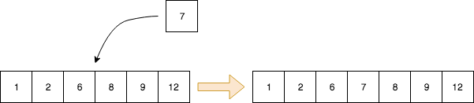
Using Ordered Array
// insert an item at the appropriate position of the // queue so that the queue is always ordered void enqueue(int item) { // Check if the queue is full if (n == MAX_SIZE - 1) { printf("%s\n", "ERROR: Queue is full"); return; } int i = n - 1; while (i >= 0 && item < queue[i]) { queue[i + 1] = queue[i]; i--; } queue[i + 1] = item; n++; }
// remove the last element in the queue int dequeue() { int item; // Check if the queue is empty if (n == 0) { printf("%s\n", "ERROR: Queue is empty"); return -999999; } item = queue[n - 1]; n = n - 1; return item; }
The item is inserted in such a way that the array remains ordered i.e., the largest item is always in the end.

Slide 11
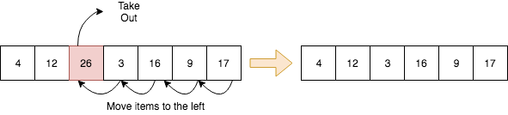
Using Unordered Array
// insert an item at the rear of the queue void enqueue(int item) { // Check if the queue is full if (n == MAX_SIZE - 1) { printf("%s\n", "ERROR: Queue is full"); return; } queue[n++] = item; } // removes the item with the maximum priority // search the maximum item in the array and replace it with // the last item int dequeue() { int item; // Check if the queue is empty if (n == 0) { printf("%s\n", "ERROR: Queue is empty"); return -999999; }
int i, max = 0; // find the maximum priority for (i = 1; i < n; i++) { if (queue[max] < queue[i]) { max = i; } } item = queue[max]; // replace the max with the last element queue[max] = queue[n - 1]; n = n - 1; return item; }
Dequeue operation in an unordered array

Slide 12
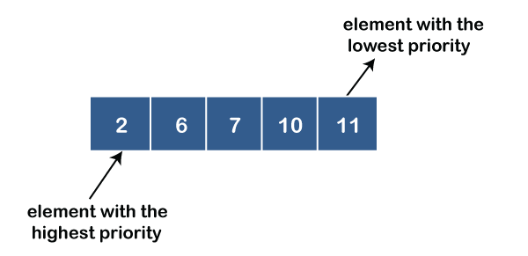
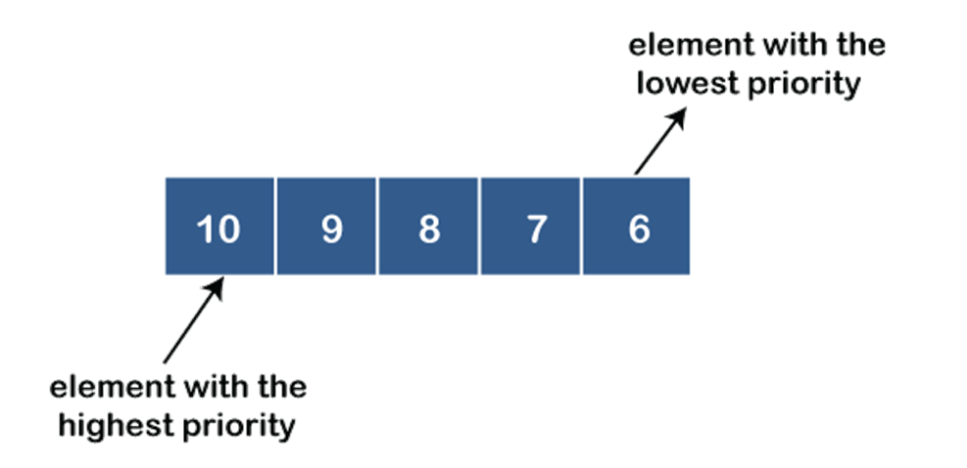
TYPES OF PRIORITY QUEUE
1.Ascending order priority queue:
In ascending order priority queue, a lower priority number is given as a higher priority in a priority.
2.Descending order priority queue:
In descending order priority queue, a higher priority number is given as a higher priority in a priority

Slide 13
IMPLEMENTATION OF PRIORITY QUEUE USING HEAP
Heaps are great for implementing a priority queue We use a max-heap for a max-priority queue and a min-heap for a min-priority queue.
The max heap is a binary heap in which a parent node has a value either equal to or greater than the child node value.
The root node of the tree has the highest value.
Notes:
Emoji & Diagram

Slide 14
1. Inserting an Element in a Max Heap Binary Tree
Algorithm
1.If the tree is empty and contains no node,
create a new parent node new Element.
2.else (a parent node is already available)
insert the new Element at the end of the tree (i.e., last node of the tree from left to right.)
3.max-heapify the tree
2.Deleting an Element in a Max Heap Binary Tree
Algorithm
1.If the elementUpForDeletion is the last Node,
delete the elementUpForDeletion
2.else replace elementUpForDeletion with the last Node
3.delete the elementUpForDeletion
4.max-heapify the tree

Slide 15
There are mainly 4 operations we want from a priority queue:
1. Insert
2. Maximum/Minimum
3. Extract Maximum/Minimum
4. Increase/Decrease key

Slide 16
Insert
INSERT(A, key)
heap_size = heap_size+1 // increasing heap size by 1
A[heap_size] = -infinity // making last element very less
INCREASE-KEY(A, heap_size, key) // chaning key of last element
Note:
All the steps are constant time taking steps, except the Increase/Decrease key.So, it will take
O(lg n) time

Slide 17
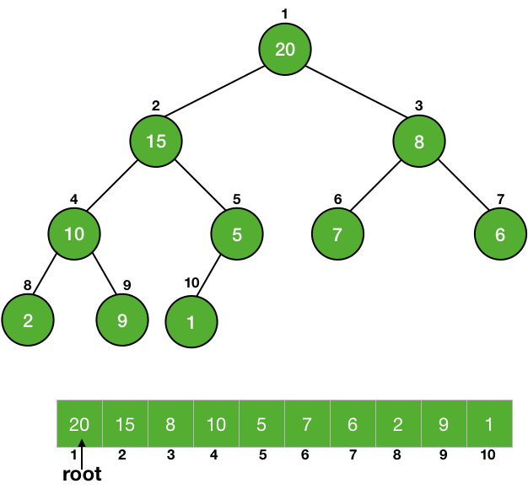
Maximum/Minimum
MAXIMUM(A)
return A[1]
Note:
Returning an element from an array is a constant time taking process, so it is a process.
Θ(1)

Slide 18
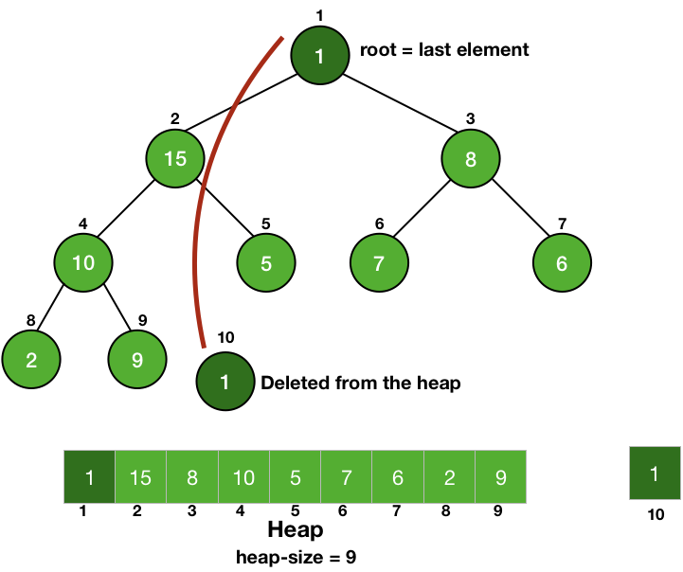
Extract Maximum/Minimum
EXTRACT-MAXIMUM(A)
max = A[1] // stroing maximum value
A[1] = A[heap_size] // making root equal to the last element
heap_size = heap_size-1 // delete last element
MAX-HEAPIFY(A, 1) // root is not following max-heap property
return max //returning the maximum value
Note:
All the steps are constant time taking process except the Heapify operation, it will take
O(lg n) time

Slide 19
Increase/Decrease key
INCREASE-KEY(A, i, key)
A[i] = key // changing key
while i > 1 and A[Parent(i) < A[i] // if parent is less than A[i], we will swap.
swap (A[i], A[Parent(i)])
i = Parent(i)
DECREASE-KEY(A, i, key)
A[i] = key // changing key
MAX-HEAPIFY(A, i)
Note:
It is similar to Heapify operation. Instead of traveling down the tree, we are traveling up, so it is also going to take lg n time in the worst case i.e., it is an O(lg n)operation.
Notes:
Emoji

Slide 20
Implementation of priority queue using linked list
Prerequisites :
Linked Lists, Priority Queues
The list is so created so that the highest priority element is always at the head of the list.
To insert an element we must traverse the list and find the proper position to insert the node so that the overall order of the priority queue is maintained.
This makes the push() operation takes O(N) time. The pop() and peek() operations are performed in constant time.
Notes:
emoji

Slide 21
Algorithm
PUSH(HEAD, DATA, PRIORITY)
Step 1: Create new node with DATA and PRIORITY
Step 2: Check if HEAD has lower priority. If true follow Steps 3-4 and end. Else goto Step 5.
Step 3: NEW -> NEXT = HEAD
Step 4: HEAD = NEW
Step 5: Set TEMP to head of the list
Step 6: While TEMP -> NEXT != NULL and TEMP -> NEXT -> PRIORITY > PRIORITY
Step 7: TEMP = TEMP -> NEXT
[END OF LOOP]
Step 8: NEW -> NEXT = TEMP -> NEXT
Step 9: TEMP -> NEXT = NEW
Step 10: End
POP(HEAD)
Step 2: Set the head of the list to the next node in the list. HEAD = HEAD -> NEXT.
Step 3: Free the node at the head of the list
Step 4: End
PEEK(HEAD):
Step 1: Return HEAD -> DATA
Step 2: End

Slide 22
APPLICATIONS OF PQ
The following are some of the most popular applications of the priority queue:
1.Dijkstra’s Shortest Path Algorithm: When the graph is stored in the form of adjacency list or matrix, priority queue can be used to extract minimum efficiently when implementing Dijkstra’s algorithm.
2.Prim’s algorithm: It is used to implement Prim’s Algorithm to store keys of nodes and extract minimum key node at every step.
3.Data compression: It is used in Huffman codes which is used to compresses data.

Slide 23
4.Artificial Intelligence : A* Search Algorithm: Finds the shortest path between two vertices of a weighted graph, trying out the most promising routes first. Priority queue (Fringe) is used to keep track of unexplored routes.
5.Heap Sort: Heap sort is typically implemented using Heap which is an implementation of Priority Queue.
6.Operating systems: Used for load balancing (load balancing on server), interrupt handling, select the next process to run, ensuring high-priority tasks run before low-priority ones.
7.Bandwidth Management: Utilized to prioritize the important data packet, so the network can make sure that those packets reach the destination as quickly as possible.

Slide 24
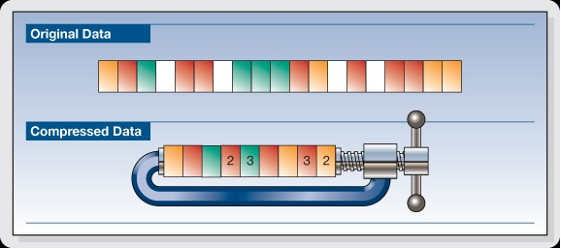
Application of Priority Queue in Data Compressions
Data compression is the process of encoding, restructuring or otherwise modifying data in order to reduce its size.
Fundamentally, it involves re-encoding information using fewer bits than the original representation.

Slide 25
HUFFMAN CODING:
It is a lossless data compression algorithm. In this algorithm, a variable-length code is assigned to input different characters.
The code length is related to how frequently characters are used. Most frequent characters have the smallest codes and longer codes for least frequent characters.
For an example, consider some strings “YYYZXXYYX”, the frequency of character Y is larger than X and the character Z has the least frequency. So the length of the code for Y is smaller than X, and code for X will be smaller than Z.

Slide 26
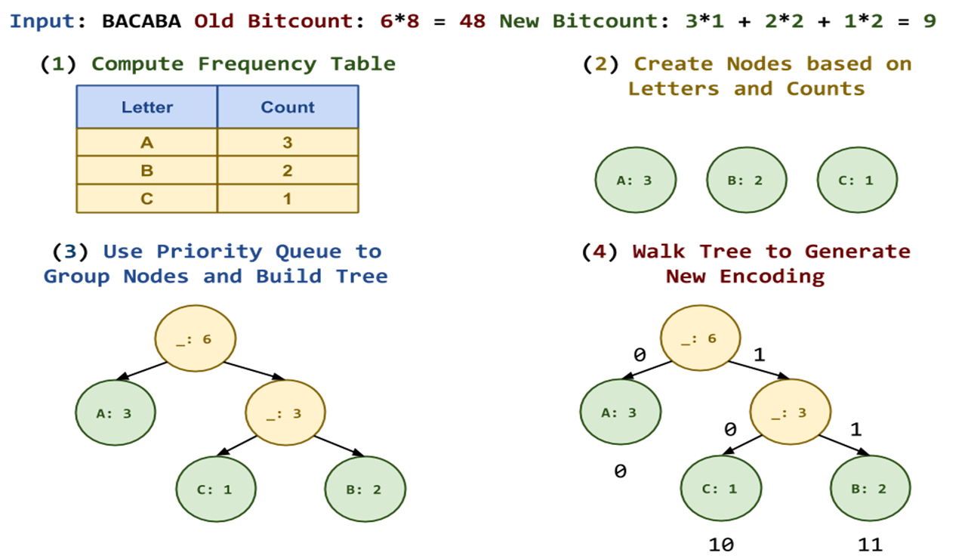
Algorithm of Huffman Coding using Priority Queue
Push all the characters in ch[] mapped to corresponding frequency freq[] in priority queue.
To create Huffman Tree, pop two nodes from priority queue.
Assign two popped node from priority queue as left and right child of new node.
Push the new node formed in priority queue.
Repeat all above steps until size of priority queue becomes 1.
Traverse the Huffman Tree (whose root is the only node left in the priority queue) to store the Huffman Code.
Print all the stored Huffman Code for every character in ch[].

Slide 27
Heap Sort
This algorithm is a sorting algorithm, like insertion sort, mergesort, quicksort and so on.
Heapsort relies on a specific type of priority queue called a “heap” (which is why it’s called “heapsort”).
Real life implementation of Heap Sort can be done in finding matching documents.
Suppose you have a document 'A' and you want to find the closest documents to it from a set of documents D1, D2...Dn .
Now one would iterate over Di s to find which documents are close, but how to store the knowledge we get from these comparisons?
A can be 20 Units similar to D1 and 24 Units to D2, and so on.
A trivial method can be to make a new array simi, where simi[i] = Similarity(A,D[i]).
Notes:
emoji

Slide 28
Heap sort Algorithm
It is easy to write down the algorithm for Heapsort.
Idea as follows:
Given unsorted array A, build heap on A, using Build-Max-Heap
Extract largest element (is in A[1]), and move it to the end of array (swap A[1] and A[n])
Decrease the size of the heap by 1
The root might not satisfy the heap property (that’s where the element formerly in A[n] now is), hence, using Max-Heapify, correct the heap
Extract the 2nd-largest element (again, in A[1]), and so on. . .
Notes:
Emoji or diagram

Slide 29
Heap Sort Complexity
Time Complexity
Best | O(nlog n)
Worst | O(nlog n)
Average | O(nlog n)
Space Complexity | O(1)
Stability | No
Heap Sort has O(nlog n) time complexities for all the cases ( best case, average case, and worst case).
Notes:
Diagram or Emoji

Slide 30
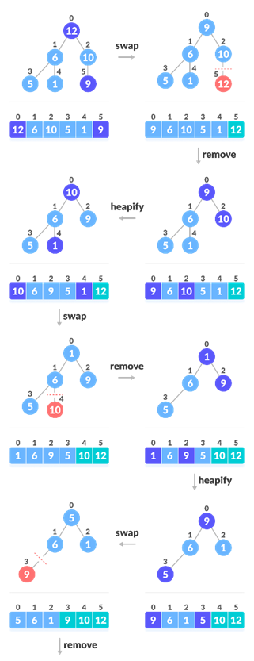
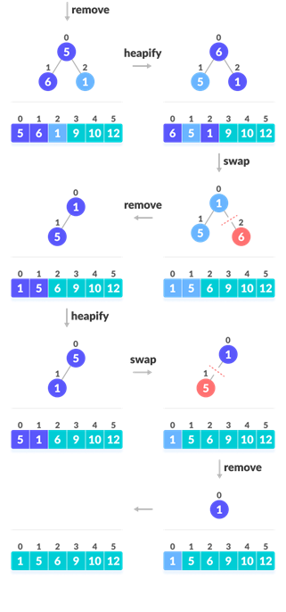

Slide 31
References
https://www.powershow.com/view/254292-YmY3N/Priority_Queues_powerpoint_ppt_presentation
https://www.upgrad.com/blog/priority-queue-data-structure
https://www.etutorialspoint.com/index.php/687-priority-queue-using-array-in-c-programming
https://www.atnyla.com/tutorial/priority-queue-implementation-using-array/3/322
https://algorithmtutor.com/Data-Structures/Tree/Priority-Queues/
https://prepinsta.com/c-program/priority-queue-using-arrays/#:~:text=Priority%20Queue%20implementation%20using%20array,element%20has%20its%20own%20priority
https://www.researchgate.net/publication/317205337_Multiresolution_Priority_Queues
https://ieeexplore.ieee.org/abstract/document/8340522
https://ijirt.org/master/publishedpaper/IJIRT100828_PAPER.pdf
http://hjemmesider.diku.dk/~jyrki/PE-lab/Claus/phdthesis.pdf
https://www.scirp.org/journal/paperinformation.aspx?paperid=25148
http://ijariie.com/AdminUploadPdf/COMPARATIVE_STUDY_OF_PRIORITY_QUEUE_IMPLEMENTATIONS_ijariie4777.pdf
https://www.irjet.net/archives/V6/i6/IRJET-V6I6737.pdf
https://www.tsijournals.com/articles/design-based-on-queue-data-structure-and-its-implementation-in-dna-computer.pdf

Slide 32
Thank You

